Slide 1
Type Conversion
  A type cast is basically a conversion from one type to another. There are two types of type conversion
  Implicit
  Explicit

Slide 2
Type Conversion - Types
Implicit type conversion :
  Done by the compiler on its own, without any external trigger from the user.
  Generally takes place when in an expression more than one data type is present. In such condition type conversion (type promotion) takes place to avoid lose of data.
  All the data types of the variables are upgraded to the data type of the variable with largest data type.
  bool -> char -> short int -> int -> unsigned int -> long -> unsigned -> long long -> float -> double -> long double
  It is possible for implicit conversions to lose information, signs can be lost (when signed is implicitly converted to unsigned), and overflow can occur (when long long is implicitly converted to float

Slide 3
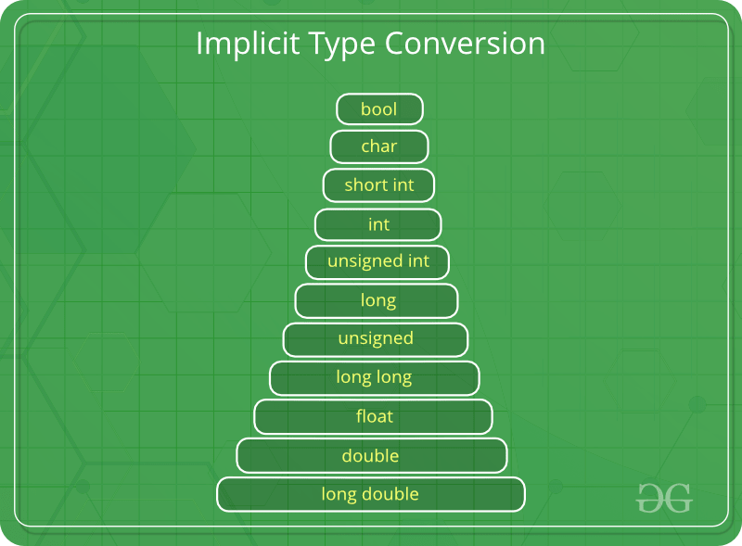

Slide 4
Implicit type conversion
// An example of implicit conversion
#include<stdio.h>
int main()
{
int x = 10; // integer x
char y = 'a'; // character c
// y implicitly converted to int. ASCII
// value of 'a' is 97
x = x + y;
// x is implicitly converted to float
float z = x + 1.0;
printf("x = %d, z = %f", x, z);
return 0;
}

Slide 5
OUTPUT:
x = 107, z = 108.000000

Slide 6
EXPLICIT TYPE CONVERSION:
This process is also called type casting and it is user defined. Here the user can type cast the result to make it of a particular data type.
The syntax in C:
(type) expression

Slide 7
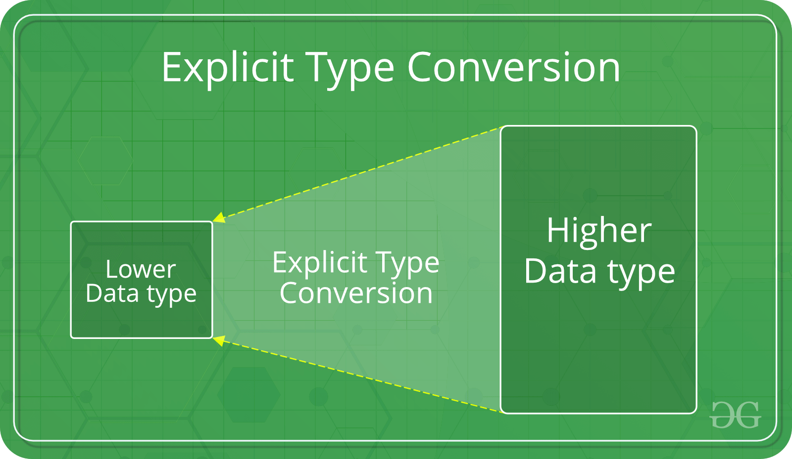

Slide 8
// C program to demonstrate explicit type casting
#include<stdio.h>
int main()
{
double x = 1.2;
// Explicit conversion from double to int
int sum = (int)x + 1;
printf("sum = %d", sum);
return 0;
}

Slide 9
OUTPUT:
sum = 2

